Slide 1
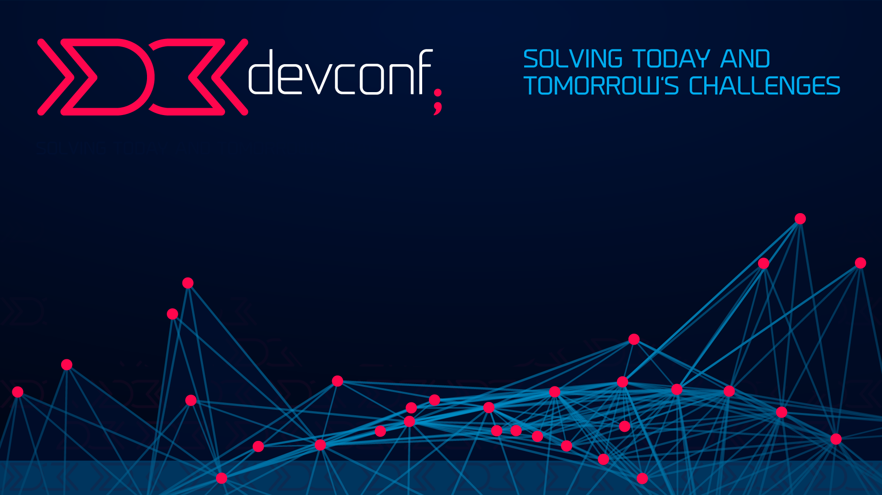

DevOps & Automation
STEVEN VAN HEERDEN
Infrastructure as Code – Using Chef to Manage Drift

Slide 2


What We Do
Derivco is a leading developer of software for the online gaming industry, used on both PC and mobile phones.

Slide 3


Where We Are
Notes:
We have offices in Durban, Pretoria, Isle of Man, UK, Estonia, Stockholm, Hong Kong and Australia.
Our Pretoria office has recently moved to Menlyn Office Park, where they are expected to grow to 50 people in the next few months. We’re looking for team leads, software developers, automation engineers, software testers and a business analyst…

Slide 4
What We Create
Derivco produces world-class gaming software and e-commerce applications for some of the largest gaming businesses in the world. The diverse variety of cutting edge games created by Derivco has rewarded many of the gaming businesses with prestigious awards. Derivco is proud to have products that set the industry bar higher than those of our competitors.

Slide 5




About Me
Notes:
I started my career at Telkom as a telephone technician, moving quickly to an automation engineer position. At DD I worked as a web developer, and have been at Derivco for the last 8 years where I currently manage the DevOps team (shock and horror – we have a DevOps team ☺)

Slide 6

Infrastructure As Code
Allows you to define your software environment using configuration scripts, and automate the provisioning of your environments
Dev
Dev
Test
Test
Stage
Stage
Prod
Prod

Slide 7
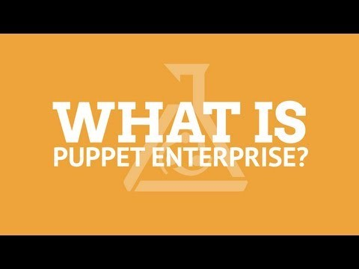

Slide 8
Getting Started
We should not treat our servers like pets...
In the past we gave them a name, and when they got sick we cared for them until they were better

Slide 9
Important Lesson!
Focus on the herd, and not the individual
Jeffrey Snover
We should rather treat our servers like cattle…
They get a number
When they get sick we light the braai!

Slide 10
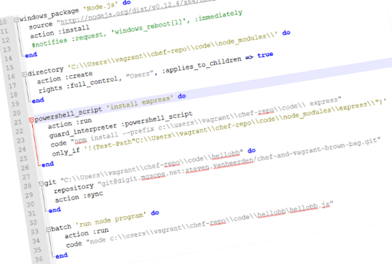

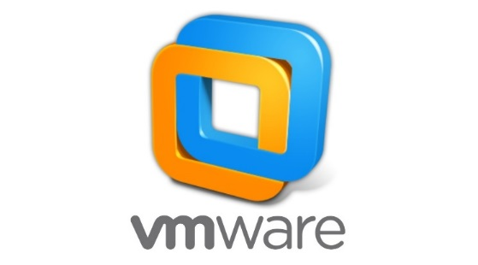

The Basics – Pre-Reqs
Base Server Image
Management
Hypervisor
Notes:
The first thing we’ll need is a base server image packaged up for us, and a place to locate it.
Then we’ll need some configuration and provisioning code.
We’ll need some management tools to run the code.
And we’ll need a hypervisor to host the environment, but it can run on bare metal if necessary

Slide 11

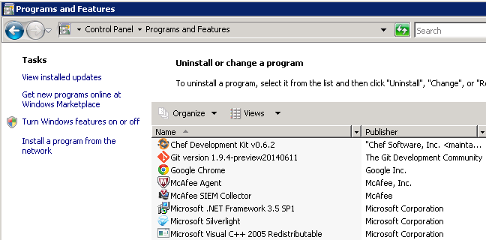
The Basics – Typical Features
Define a state for a resource
What is a resource??
A folder is a type of resource
An application (e.g. Git) is also a type of resource
Example – The Git resource should be present, if not create (install) it

Slide 12
The Basics – Typical Features
Configuration Drift
Occurs when a resource drifts from its desired state
Example – Someone manually changes a folders permissions from read-only to read/write
Only those settings that do not match will be set, resulting in faster run times
Desired State
Read/Write
Read
DRIFT!

Slide 13
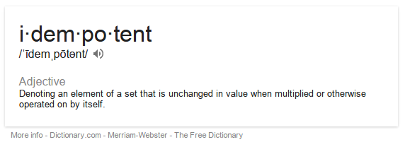
The Basics – Typical Features
Idempotency
Ensures that you can run the same configuration multiple times while achieving the same result
Desired State
Read

Slide 14


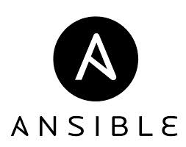


Infrastructure As Code Applications
Puppet
Chef
Ansible
PowerShell (ver. 4.0)
And more…

Slide 15
Managing Build Servers
We needed to manage 12 “identical” Windows build servers
Combat configuration drift
Tested Puppet, Ansible and Chef
POC was run over 6 weeks
We found knowledge was transferable between applications
All used PowerShell to perform Windows specific functions (e.g. restarts)

Slide 16




Master
Notes:
Developers write chef scripts and commit to their own branch in version control
Merge request for merge into master
Merge into master commits changes to the Chef server using Knife
TeamCity runs the Chef agent on each build server every 6 hours (15mins before the hour)
Chef agent on build server retrieves the latest cookbooks/recipes and applies them

Slide 17
What We Have Learnt
Running any infrastructure as code tool is a difficult balancing act alongside enterprise security
Security needs, although necessary will probably make your life difficult
Always keep your security department happy!

Slide 18
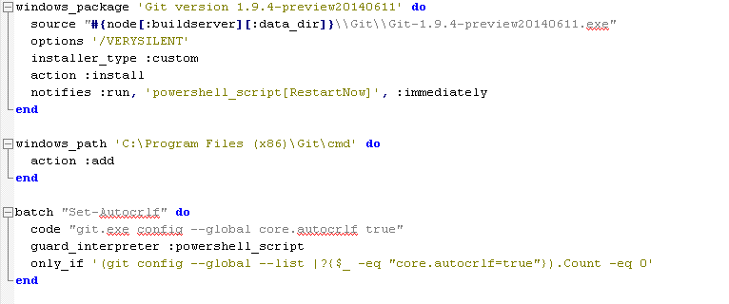
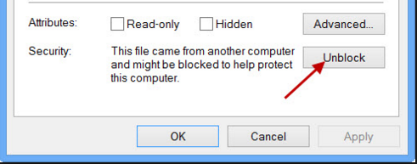
What We Have Learnt
Gotchas on Windows!
Applications downloaded from the internet require you to unblock them, or Chef won’t be able to work with them
Use full names of applications in your recipes, or Windows won’t recognise them correctly

Slide 19
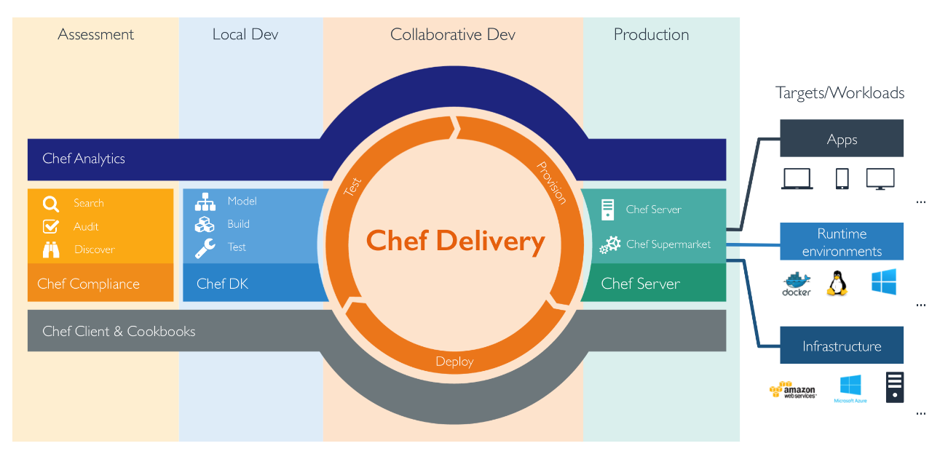
What We Have Learnt
If we started again…
Any of the leading tools (Puppet, Chef, Ansible, etc.) in combination with PowerShell DSC provide a suitable solution
Chef can do so much more than manage a handful of build servers

Slide 20
Chef Terminology
Recipes
Cookbooks
Knife
Test Kitchen
Test harness for different
platforms e.g. Vagrant, Amazon, etc.
Food critic
Ensures recipes are “Kosher” ☺
Notes:
knife is a command-line tool that provides an interface between a local chef-repo and the Chef server.
knife helps users to manage:
Nodes
Cookbooks and recipes
Roles
Stores of JSON data (data bags), including encrypted data
Environments
Cloud resources, including provisioning
The installation of the chef-client on management workstations
Searching of indexed data on the Chef server

Slide 21
Chef Basics… Getting Started ☺
Resource
Represents a piece of the system
Recipe
a collection of resources (instructions & configuration data) that achieve a goal (written in Ruby)
Cookbook
a container that holds one or more recipes, templates, configuration settings, and metadata that work together to provide a package or perform an actionable item such as installing PostgreSQL

Slide 22
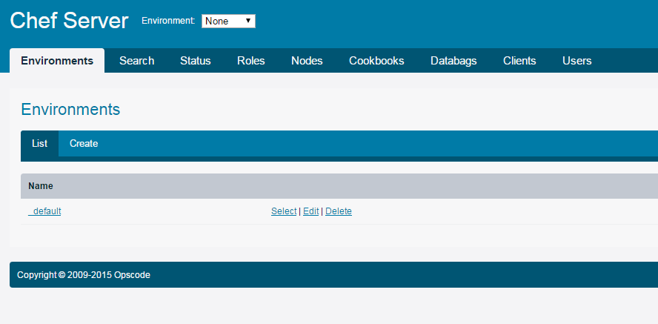
Chef Basics
Roles
user-defined collection of recipes and configuration values that describe some sort of common configuration e.g. "MySQL Server"
Nodes
Servers
Environments
Dev, Test, etc.
> Chef Local Mode
Great for learning and testing cookbooks/recipes
> Chef Server
Free for 25 nodes
> Chef Enterprise
Free for 5 nodes

Slide 23

Questions??
https://www.chef.io/
https://learn.chef.io/
http://learnrubythehardway.org/book/

Slide 24
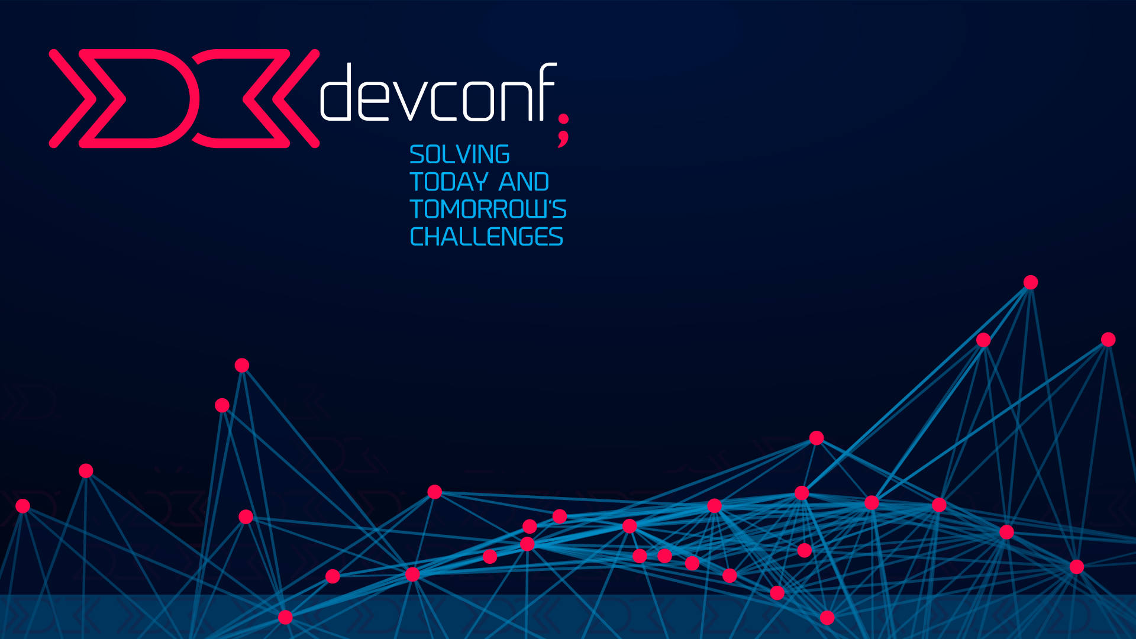
/* THANK YOU*/
STEVEN VAN HEERDEN
Derivco
steven.vanheerden@derivco.co.za
+27 31 5801000
http://jointhelegacy.co.za/
http://www.devconf.co.za/

